Slide 1

L2 health
Do now
Create a line standing in alphabetical order of your first name

Slide 2
Learning intention
BY THE END OF THE LESSON, I SHOULD BE ABLE TO:
BUILD KNOWLEDGE OF LEARNERS IN MY LEVEL 2 HEALTH CLASS

Slide 3
ABOUT ME
Mrs Tamihere
Tirohanga Whanau Leader
Health & Physical Education, Learning Leader
Alfriston College 2021

Slide 4

expectations
Time
Attendance
Uniform
Stationery
Whanau Contact
Completing Assessments
Academic Tracking and Mentoring
Firm but FUN!

Slide 5
Google classroom
code:
kshducv
Slides for each Term
Handing in assessments
Communication
Access to resources

Slide 6
Group - Scattergories
Get into groups of 4 - each person must be from a different whanau. Sit in your group of 4
On a piece of paper draw the following table:
Healthy Food | Word related to AC or the AC way | Marvel Character | Learning Leader | NZ town | Way to improve your well-being

Slide 7
task
Blue Post It Note: Write down what health is to you.
Yellow Post It Note: Write down what you want to get from this course
Orange Post It Note: Write down 3 people that make you the best version of yourself

Slide 8
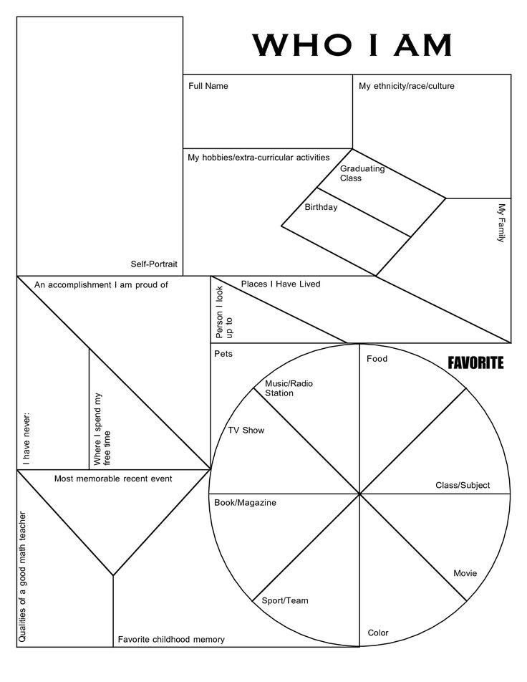
Worksheet: Who am i?
Fill in the worksheet - handwriting needs to be your tidiest!
Colour it in using colouring pencils and felts
Once complete get a photo taken by Mrs Tamihere
Laminate this once your photo has been printed

Slide 9
L2 health
Do now
Create a line standing in order of birthdate, youngest to oldest

Slide 10
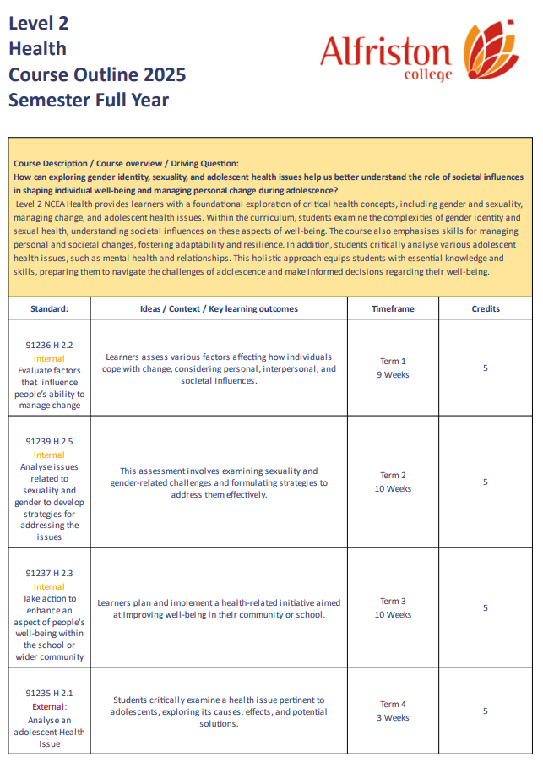
Course outline
Glue this into your books
Get into pairs and read the course outline together
Create a word list of of up to 10 words that you don't understand or what like to know more about

Slide 11

Groups - pipeline
reflection
Get into groups of 6 - your group must have a range of different people that you have not been in a group with today. Sit in your group of 6.
Create a pipeline using the pipes to get your ping pong ball to travel throughout the pipe
What emotions did you feel when completing that activity? What worked successfully in your team? What didnt work so well?

Slide 12
Worksheet: Who am i?
Fill in the worksheet - handwriting needs to be your tidiest!
Colour it in using colouring pencils and felts
Once complete get a photo taken by Mrs Tamihere
Laminate this once your photo has been printed

Slide 13
Talk, draw observe
Organise yourselves to get into groups of 4
Within your group each person will start with one of the following roles:
  Communicator
  Listener/Drawer
  Observer
The Communicator will have 30 seconds to look at a picture (on next slides - feel free to print) that the learning leader will be holding then has explain to the listener/drawer how to draw the picture they have just seen
The listener/drawer will have to 1 minute to draw as much of the picture as possible before everyone in your group changes roles
communicator → Listener drawer → Observer → Communicator

Slide 14

Talk | draw | observe

Slide 15

L2 health
Do now - WK 4
Complete your who am I worksheet.
Laminate it, add velcro to the back four corners then put it on our class wall

Slide 16
Learning objective
WE ARE LEARNING TO:
BUILD KNOWLEDGE AND MAKE SENSE OF RESILIENCE
BUILD KNOWLEDGE OF FACTORS & STRATEGIES THAT IMPACT RESILIENCE

Slide 17
SUCCESS CRITERIA
BY THE END OF THE LESSON, I SHOULD BE ABLE TO:
DEFINE RESILIENCE
COMPARE AND CONTRAST RISK FACTORS VS PROTECTIVE FACTORS

Slide 18
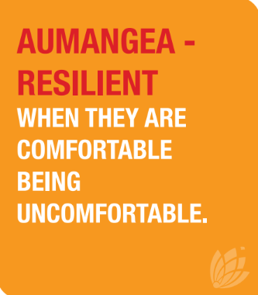
GROUP TASK - RESILIENCE
Organise yourselves to get into groups of 4
Collect a RESILIENCE brain dump worksheet
As a group write down all the things you think RESILIENCE -
looks, sounds and feels like

Slide 19
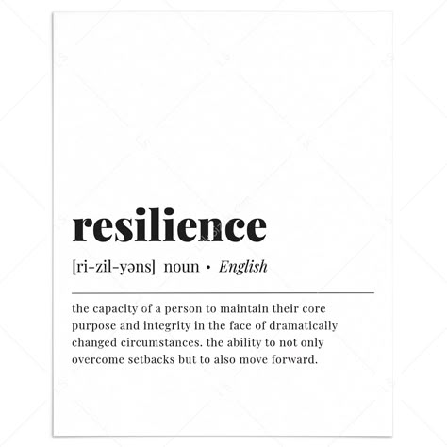
Definition - resilience
Resilience is “the process of adapting well in the face of adversity, trauma, tragedy, threats or even significant sources of stress - such as family and relationship problems, serious health problems or workplace and financial stressors. It means ‘bouncing back’ from difficult experiences.”

Slide 20
Barriers to resilience
Being alone
Not taking care of our bodies
Focusing on the negative
Holding onto your feelings
Losing hope
Harmful coping strategies
Don’t have anyone to lean on or support us
Adds physical stress to our bodies, can affect how we see and respect ourselves
No room for positive thoughts makes it harder to find solutions
Negative feelings can fester and grow, making it harder to see any positives
Makes it hard for us to see how things can ever get better
Relying on harmful actions (i.e alcohol, ignoring the problem etc) can temporarily make us feel better, but doesn’t actually solve or help the problem in the long run

Slide 21
Actions that build resilience
Strong, positive relationships
Reminds us we are not alone, getting support from others helps us feel validated
Taking care of your body
Helps us to cope with the physical effects of stress, shows us small parts of our life that we can control
Helping others
It feels good to help others which helps give us a sense of purpose, it shows us we are not the only ones who need help and that there are people who want to help us
Focus on your goals
Helps us to know we can make changes, and focus on what we really want instead of what we might be lacking
Accept & manage change
Reminds us there are things we can’t change, and to focus on the things we can change

Slide 22
Actions that build resilience
Stay open minded
Staying positive and open to all options helps us to find solutions quicker
Positive outlook
Helps us to understand that, just as bad things happen, good things can also, and that better days are coming
Reflect & Learn
Reminds us where we’ve been, what we’ve overcome already - which helps us to remain hopeful that we will come through the current difficulties as well
Seek help
Other people may be able to provide solutions that we may not have thought of, or that we can’t access on our own.

Slide 23
Group task - risk vs protective
In groups take a Risk Factors & Protective Factors worksheet and highlight the risk factors to someone's well-being in one colour and the protective factors in another colour
Once completed we will go through them as a class
Risk Factors
Increase the likelihood of harm
Protective Factors
Decrease the likelihood of harm

Slide 24

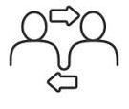

STRATEGIES TO MANAGING CHANGE
PERSONAL
COMES FROM WITHIN THE PERSON ALONE
INTERPERSONAL
COMES FROM THE INTERACTIONS WE HAVE WITH OTHERS/SMALL GROUPS
SOCIETAL
COMES FROM ANYTHING BIGGER OUTSIDE OF YOU OR THE SMALL GROUPS AROUND YOU

Slide 25
PAIR WORK TASK
Using the worksheet explain:
1. identify three risk factors & three protective factors
2. How can resilience be built
3. come up personal, interpersonal and societal strategies for the following scenario:
Matiu is 45 year old male of Maori descent, from age 18-33 he smoked cigarettes daily and stopped when he had his first child at 33. Recently, his 70 year old father passed away from lung cancer - his father was a heavy smoker. Matiu is still dealing with the loss of his father which has triggered him to have a ciggarette every other day to deal with the stress of his fathers, funeral costs and supporting other members of his whanau with the loss of their father. Matiu has a caring wife and has raised her concern over him smoking again. Matiu has agreed to do something about it but is finding it difficult to stop. He has good job that pays good money, where requires him to be physically fit and smoking will have an impact on his work productivity, it is also an expensive habit. He knows that his kids were a good reason for him to give up smoking all those years ago and he doesnt want the same thing that happened to his dad to happen to him.s three children are the most important thing to him. Matiu’s wife is concerned that he might take up smoking again and he has agreed that he will try to stop for the sake of his family and the reason for his fathers death, however this is proving easy said then done.

Slide 26
Independent task - scenario 2
Using the worksheet explain:
1. identify three risk factors & three protective factors
2. How can resilience be built
3. come up personal, interpersonal and societal strategies for the following scenario:
Mary is an 16 year old female at AC. She gets along well with her learning leaders, gets good grades, plays sport and has a part-time job at the local plant store. Although, she is shy and knows people at school she doesn't have any close friends and a lot of the time she feels lonely and like she is missing out socially. Mary’s parents have high paying jobs and have high expectations for her to achieve in all the things she is involved in and whilst she likes achieving Mary has come to the realisation that she feels sad more than happy with her life and wants to have more fun in her life. When she tried to talk to her parents about being invited to the movies with people from school on the weekends her parents just said “you can't, cause you have sport and work” and felt she couldn't get through to them

Slide 27
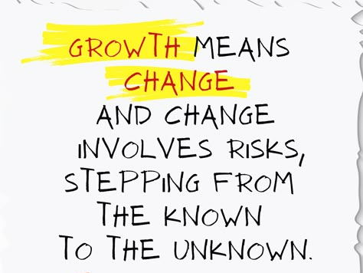
L2 health
Do now - WK 4
Talk to the person next you about what you think this quote means
Discuss what you think about change - is it hard/easy? Is it the same for everyone?

Slide 28
Learning objective
WE ARE LEARNING TO:
BUILD KNOWLEDGE AND MAKE SENSE OF THE SOCIAL DETERMINANTS OF HEALTH

Slide 29
SUCCESS CRITERIA
BY THE END OF THE LESSON, I SHOULD BE ABLE TO:
NAME THE SOCIAL DETERMINANTS OF HEALTH
GIVE EXAMPLES OF EACH OF THE SOCIAL DETERMINANTS OF HEALTH

Slide 30





What are social determinants of health?
World Health Organisation (WHO) defines the social determinants of Health are non-medical factors that influence health outcomes. They are the conditions in which people are born, grow, work, live, and age, and the wider set of forces and systems shaping the conditions of daily life.
Socio -
Economic
Government
Environment
Cultural
Social Environment

Slide 31
What do they mean?
Socio-Economic
Income, education, employment and community safety
Cultural
The groups of people you associate with their views, traditions and beliefs
Government
The policies, rules and systems that allow or prevent you from access to health support
Social Environment
Upbringing, final capability, family and peer influences
Environment
The physical environment - is it clean, unpolluted and has appropriate facilities to support health needs

Slide 32

In groups of 4-5, you will be given one social determinant and come up with both positive and negative impacts they have on vaping
Socio-Economic
Income, education, employment and community safety
Cultural
The groups of people you associate with their views, traditions and beliefs
Government
The policies, rules and systems that allow or prevent you from a
Social Environment
Upbringing, final capability, family and peer influences
Environment
The physical environment is it clean, unpolluted and has appropriate facilities to support health needs

Slide 33
Positive and negative impacts that social determinants have on vaping
Socio-Economic
Cultural
Government
Social Environment
Environment

Slide 34

L2 health
Do now - WK 4
Go to university after Year 13 - have all your university fees paid for
After Year 13, work a job that pays a pretty good salary but is not your passion

Slide 35
Learning objective
WE ARE LEARNING TO:
BUILD KNOWLEDGE AND MAKE SENSE OF OUR 2.2 MY RESILIENT ROLE MODEL ASSESSMENT

Slide 36
SUCCESS CRITERIA
BY THE END OF THE LESSON, I SHOULD BE ABLE TO:
CREATE A LIST OF 5 THINGS THAT I NEED TO KNOW MORE ABOUT FOR 2.2

Slide 37

Complete this word cloud
Using your chromebook go to this website link - https://www.menti.com/alumu9bm1jyy
Enter the code - 86304735
Type in all the things that you remember learning about in yesterday’s health lesson

Slide 38
2.2 - my resilient role model Part 1
Go into your L2 Health Folder in Google Drive
Open the 2.2 My Resilient Role Model Assessment
Read through the assessment with someone else - if you dont have a chromebook sit with someone who does
As your reading the assessment - write down questions or response under the following headings.
Thinking back to yesterday’s lesson what do you feel like need to know more about to complete this assessment?
Questions you have about the assessment?

Slide 39
2.2 - must knows!
Resilient Role Model must be someone who has experienced a significant change that has caused them some type of hardship
Must be approved by LL (TE)
There will be a deadline for Role Model Selection - Week 6, Lesson 2
Examples will be provided to select from
Checkpoint at Week 8 for each individual learner
No feedback given in last week of term in lead up to the due date
Marked over school holidays - grades given at start of Term 2
Re-submission considered for learners
Not handing in your assessment is not considered an acceptable standard

Slide 40
Mix & Match - Social Determinants
Using your prior knowledge, match the picture with heading and the description for the Social Determinants of Health

Slide 41
Risk, Protective & Strategies
Describe one risk factor and one protective factor along with one personal, one interpersonal and one societal strategy for one of the following:
Exposure to bullying and abuse
Heavy alcohol and drug use
Mental health - depression & anxiety
Transient living - moving houses regularly and having to move schools

Slide 42
L2 health
Do now - WK 5
Collect a piece of refill paper and write down all the people you would consider writing about for your My Resilient Role Model assessment.
Remember the person needs to have a significant event happened in their life, whereby they have had to go through a change and shown resilience with that change

Slide 43
Learning objective
WE ARE LEARNING TO:
MAKE SENSE OF PERSONAL, INTERPERSONAL, SOCIETAL (PIPS)RISK FACTORS, PROTECTIVE FACTORS AND STRATEGIES

Slide 44
SUCCESS CRITERIA
BY THE END OF THE LESSON, I SHOULD BE ABLE TO:
IDENTIFY PIPS RISK & PROTECTIVE FACTORS IN MY OWN LIFE TO MANAGE MY SELF
USE PIPS STRATEGIES TO MANAGE THE RISK FACTORS IN MY LIFE

Slide 45
RECAP - PERSONAL | INTERPERSONAL | SOCIETAL (pips)
PERSONAL
COMES FROM WITHIN THE PERSON ALONE
INTERPERSONAL
COMES FROM THE INTERACTIONS WE HAVE WITH OTHERS/SMALL GROUPS
SOCIETAL
COMES FROM ANYTHING BIGGER OUTSIDE OF YOU OR THE SMALL GROUPS AROUND YOU

Slide 46
THE IMPACT OF CHANGE oN PIPS
We all have strengths (protective) and weaknesses (risks) when it comes to our well-being. Sometimes our strengths can be our weaknesses and vice versa. For example: a person who is hard worker or has a good work ethic, maybe stressed, tired and sacrificing quality time with their family.
It is important to be able to identify our protective and risk factors so that when they get out of sync or destabilize us, we can use strategies to support ourselves.
Going through a change can further destabilize or dysregulate us, therefore our strategies need to be robust and we need to build resilience to manage ourselves.

Slide 47
Independent task part 1
Identifying Risk and Protective Factors through PIPS
Using the PIPS diagram, highlight one protective factor and one risk factor from each of the circles.
From your highlight protective and risk factors, annotate on the diagram and give details of who and what that risk and protective looks like in your life (see example)
Extension
Indicate for each factor which social determinant of health impacts this factor and how.

Slide 48
Independent task part 2
PIPS Strategy
For each risk factor in each of the PIPS areas of the diagram. Come up with Personal, Interpersonal and Societal strategy.
Example:
If a personal risk factor is poor time management causing stress. A personal strategy could be purchasing a diary to use as a tool to plan out my days, create a routine and to do lists so that I can be more prepared for each day to minimise stress levels.
If a interpersonal risk factor is having friends vape when someone is trying to give up. A interpersonal strategy could be finding another group of friends to socialise with OR having a open conversation with your friends about wanting to give up vaping and ask them if they could support you by not vaping around you when you spend time with them.

Slide 49
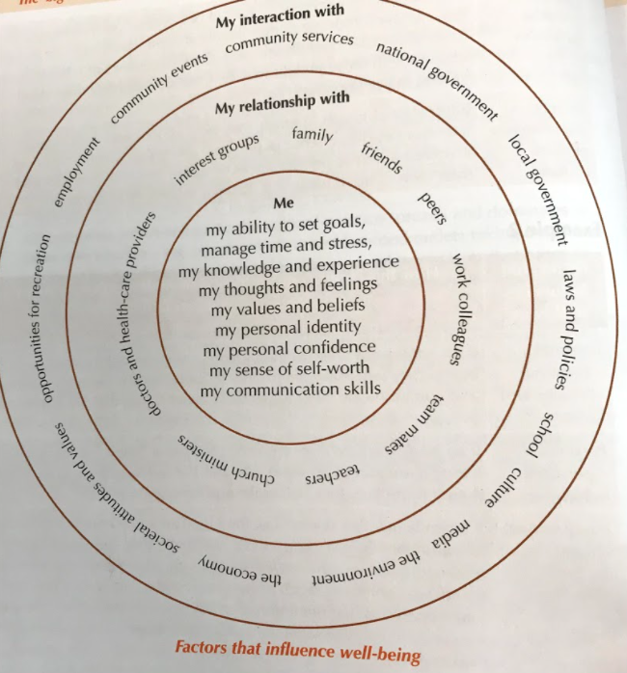

Slide 50
L2 health
Do now - WK 5
Collect a Resilient Role Model Checklist and Planning Doc
Write your name on both
This we be collected at the end of each lesson from now and until you complete your assessment
We will be watching a documentary on James Rolleston and using the planning document as a practice for our actual Resilient Role model

Slide 51
Learning objective
WE ARE LEARNING TO:
TAKE ACTION TO IDENTIFY PIPS RISK AND PROTECTIVE FACTORS IN REAL LIFE EXAMPLES OF RESILIENCE

Slide 52
SUCCESS CRITERIA
BY THE END OF THE LESSON, I SHOULD BE ABLE TO:
COMPLETE THE PRACTICE PLANNING DOCUMENT FOR MY RESILIENT ROLE ASSESSMENT

Slide 53
JAMES ROLLESTON
What do we already know about him?
Are there any risk factors or protective factors we can identify before we watch the documentary?
Which Social determinants of Health do you feel might impact him before and after the change?
REMINDER:
When watching the documentary remember to always have the SIGNIFICANT CHANGE in mind when identifying PIPS risk and protective factors. This is important as it will help you develop PIPS strategies, as practice for your assessment.

Slide 54
L2 health
Do now - WK 5
Get out your chromebooks
Open at least 3 different types of information sources (websites, articles etc) that you are going to help complete your My Resilient Role model assessment
Note: These dont have to be sources that have information about your resilient role model they can be related the health concepts we have been learning about in class

Slide 55
Learning objective
WE ARE LEARNING TO:
TAKE ACTION AND PLAN OUT OUR MY 2.2 RESILIENT ROLE MODEL ASSESSMENT

Slide 56
SUCCESS CRITERIA
BY THE END OF THE LESSON, I SHOULD BE ABLE TO:
COMPLETED A 1:1 WITH MRS TAMIHERE
MAKE SENSE OF HOW TO USE THE STRUCTURE GUIDE FOR 2.2

Slide 57
WRiting structure
Report Style Essay
Evaluation - review what has happened, review the good and the bad and review what can be improved.
For Excellence:
  your evaluation needs to be critical of resilience, risk factors, protective factors and strategies now and in the future
  Show an understanding of how changes connect/relate with other with other changes
  Link identified risk factors to social determinants of health or resilience literature
  Link and explain the relationship of risk factors to strategies
Writing structure available in your L2 Health Google Drive
Work bank that may support you with your writing on slide 58

Slide 58
Resilient role model to do list
✅ Select a Role Model
✅ Get this signed off by Mrs Tamihere
✅ Start completing your Planning Doc
✅ Get your Planning Doc checked by Mrs Tamihere
✅ Complete one on one with Mrs Tamihere

Slide 59
L2 health
Do now - WK 6
Collect your weekly report summary from week 5
Read through your Week 5 report
Check which Learning Leaders you need to follow up with regarding any missing scores
Missing Scores - might mean you were absent in the class that the LL marked the score
Needs Attention - scoring low in a class might be a reflection of your attendance, an indication that MORE effort needs to be put in OR both
Goal - write a goal for Wk.6 centred around what you would like to work on in terms of what your Wk.5 report is showing

Slide 60
Resilient role model to do list
✅ Select a Role Model - this needs to be completed by 10.15am
✅ Get your Role Model signed off by Mrs Tamihere
✅ Start completing your Planning Doc
✅ Get your Planning Doc checked by Mrs Tamihere - this needs to be finished by the end of Lesson 2
✅ Start writing your assessment:
use the writing structure and the word bank on slide 61 to complete your essay
For each paragraph you complete get this signed off by Mrs Tamihere
✅ Complete one on one with Mrs Tamihere

Slide 61
Word bank
Well-being
Risk
Protective
Positive
Negative
Change
Hauora
Resilience
Ability to Change
Impact
Social Determinants
Manage
Coping
Strategy
spiritual
physical
whanau
mental
strength
factors
influence
connection
relationships
society
lifestyle
hope
Te Whare Tapa Wha
personal
Interpersonal
Societal
Barriers
support

Slide 62
L2 health
Do now
Tues 4/3
Collect a post it, write your name on one side and what part of your 2.2 assessment you want to have completed by the end of the lesson
Put this post it on your Resilient Role Model checklist

Slide 63
Resilient role model to do list
✅ Start completing your Planning Doc if you havent done so yet
✅ Get your Planning Doc checked by Mrs Tamihere - this needs to be finished by the end of Lesson 2
✅ Start writing your assessment:
use the writing structure and the word bank on slide 61 to complete your essay
For each paragraph you complete get this signed off by Mrs Tamihere
✅ Complete one on one with Mrs Tamihere

Slide 64
L2 health
Do now
mon 10/3
If we all finish our assessment before the end of term, what health content would you like to learn about in class
Write it on a post it note and place it into the box at the front of class

Slide 65
Resilient role model to do list
✅ Planning Doc should be finished - please get this checked today if you havent already.
REMINDER you need to focus on your role model going through one significant change, there can be other changes along the way but you need to have to base your assessment one
✅ Start writing your assessment:
use the writing structure in your Google Drive> L2HEA Folder > Structure 2.2 and the word bank on slide 61 to complete your essay
For each paragraph you complete get this checked/signed off by Mrs Tamihere
✅ Complete one on one with Mrs Tamihere - Teina and Sinclair only!

Slide 66
L2 health
Do now
mon 10/3
Have you completed your PLPP in Whanau Mentor?
If not, please see me to do this.
If yes, when your PLPP is presented at LPC in Week 8 what would you like to discuss with your whanau about your learning pathway - write this down

Slide 67
L2 health
Do now
mon 17/3
Rate your motivation out of 10 when it comes to completing your 2.2 assessment to the standard you want to complete it at
Share it with the person next you
What do you need to do make your rating higher?

Slide 68
Timeline to complete 2.2
Week 8
Starting & Completing Strategy Paragraphs
Week 9
Completing Strategy Paragraphs
Getting feedback once strategies are completed (especially if you are in Polyfest Group)
Week 10
Final Feedback
Proofreading
Week 11
Final Editing, Proofreading, Finalising and Submission

Slide 69
2.2 excellence
Background (Achieved → Merit → Excellence)
Selected role model
Risk & Protective Factors
Evaluate Factors comprehensively - be critical on the influence the factors have had on the resilient role models ability to change and be resilient

Slide 70
2.2 excellence
Risk & Protective Factors
Interrelate changes and link
  Mention in a summary paragraph how changes this person had to make link to other changes in their life/lifestyle
  Explain how factors link with each other
  Identify and explain the social determinants of health
Verbal Example
Tips:
How do the risk factors all link? How do protective factors all link?
How did the connection between protective factors build resilience and support the change the person is making?
Think about all your risk & protective factors and which social determinants of health they fit with. Consider going back to your planning doc and writing which social determinant of health each factor links to. Use resources/literature to support the social determinants identified

Slide 71
2.2 excellence
Strategies
Critical in terms of change and resilience
Each strategy needs explain how it will help the resilient role model now and in the future so they continue on their change journey and continue to build resilience

Slide 72
L2 health
Do now
mon 10/3
If we all finish our assessment before the end of term, what health content would you like to learn about in class
Write it on a post it note and place it into the box at the front of class

Slide 73
Learning objective wk 9
Use knowledge of risk/protective factors, strategies that support change and resilience
Fast Finishers - part one
Go to your L2 Health Folder in Google Drive
Open the Health Extension document
Use the sentence starters to add this to your assessment
Fast Finishers - part two
Read this site about the Te Whare Tapa Wha
Collect a A4 piece paper
Create a vision board in Canva put a photo of yourself in the centre of it and of all the things that contribute to you having good wellbeing/hauora

Slide 74
Learning objective wk 10
Use knowledge of risk/protective factors, strategies that support change and resilience
Fast Finishers - part one
Go to your L2 Health Folder in Google Drive
Open the Health Extension document
Use the sentence starters to add this to your assessment
Fast Finishers - part two
Read this site about the Te Whare Tapa Wha
Collect a A4 piece paper
Create a vision board in Canva put a photo of yourself in the centre of it and of all the things that contribute to you having good wellbeing/hauora

